Slide 1

Software Engineering
Gruppo 9 – Drawing App
Lorenzo Mignone - 0622701866
Artemis Ostadimitris - 0622701874
Gaetano Parolise - 0622701919
Davide Parente - 0622701859

Slide 2
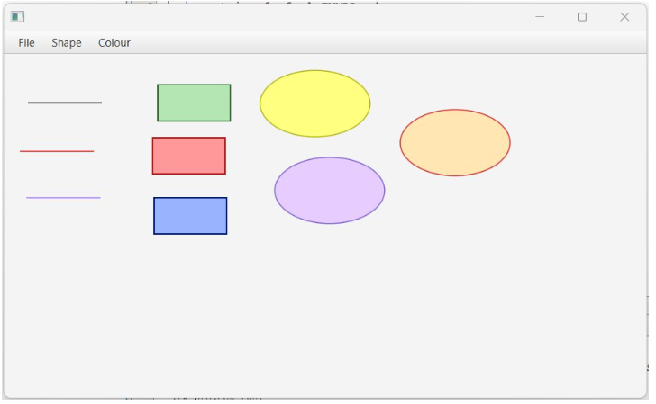
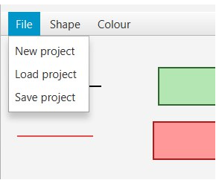
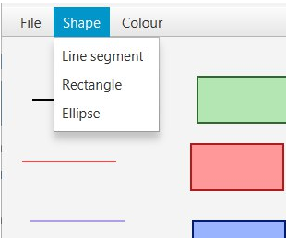
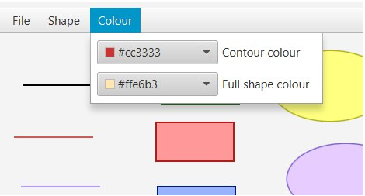
Sprint 1 - achieved goals
All tasks have been completed
Functional tests performed

Slide 3


Sprint Review
Team velocity
Estimated a priori velocity: 20 SP
Estimated retrospectively velocity: 20 SP
Problems detected
MenuBar and Canvas don’t follow properly the new anchorPane’ s dimensions when it increases in size
When the previous situation occurs then, if anchorPane decreases in size, all drawings in the new part of the canvas are lost

Slide 4
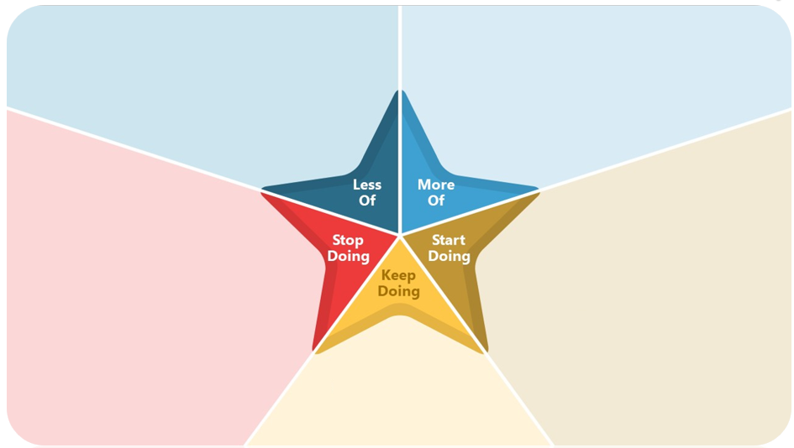
Retrospective
Comment out code
Making a good UML
More accurate estimates in term of story points
Nothing
Organize better what do in each user story
Before starting to develop a new user story, make sure to have completed the implementation and testing of the current user story
Don’t respect the convention
Continue doing meetings
Continue doing code review by all members

Slide 5
Sprint Retrospective
Problems detected
GitHub problems

Slide 6
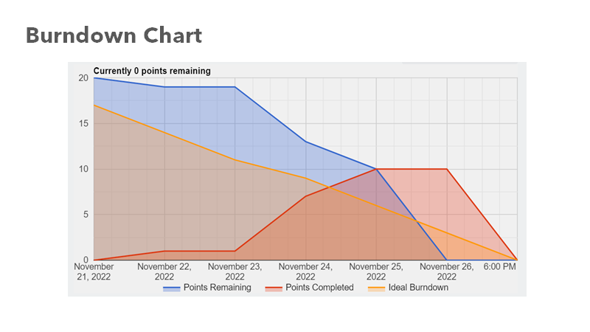
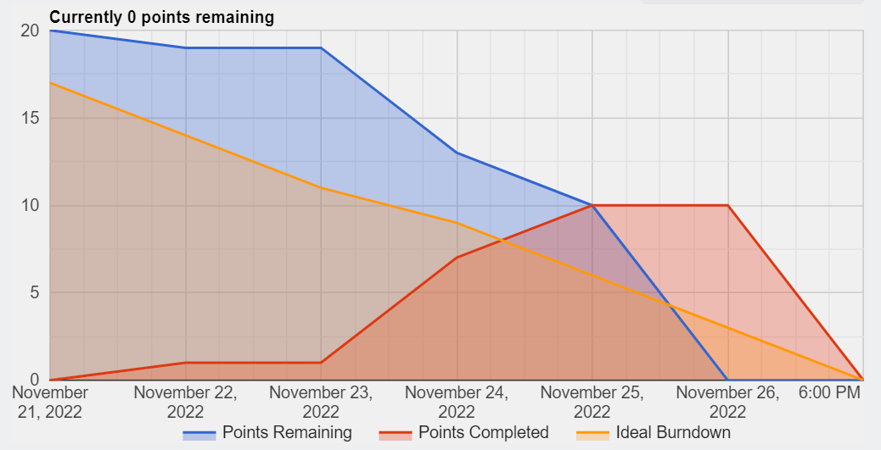
Burndown Chart

Slide 7
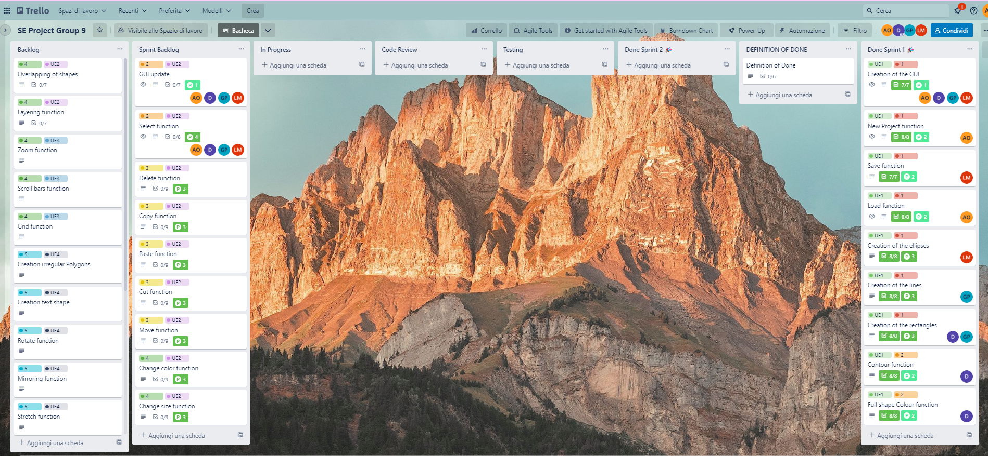
Second Sprint Backlog

